Slide 1
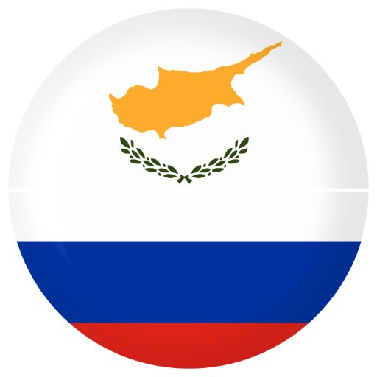
General Consulate of the Republic of Cyprus in Samara

Slide 2
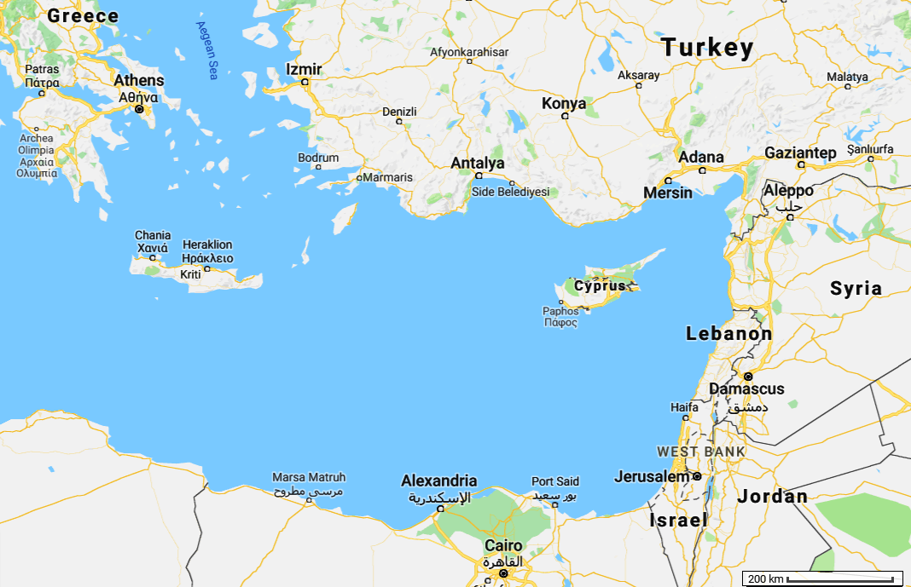

Slide 3
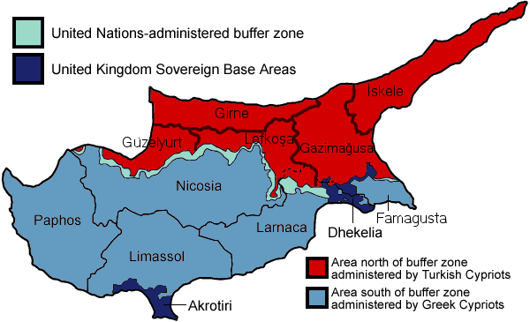
Important Historical Facts
12th century BC - The first Greeks colonized the island
1571 - Ottoman Empire had conquered Cyprus
1878 – Britain had conquered Cyprus
1960 - Cyprus attained independence after the Zürich and London Agreement between
the United Kingdom, Greece and Turkey. (Greece as guarantee country for Greek-Cypriots
and Turkey as guarantee country for Turkish-Cypriots)
1974 – Turkey invaded Cyprus and captured 36% of Cyprus
2004 - Cyprus joined the European Union
2008 – Cyprus adopted euro (€).

Slide 4
Education System in Cyprus
Pre-Primary School
5-6 years old
Primary School
6-12 years old
Secondary School
Gymnasium 12-15 years old
Lyceum 15-18 (includes both common core subjects and optional subjects of specialization and enrichment)
Or
Secondary Technical and Vocational Education (provides “theory” and “practice”)
Higher Education
43 Private Institutions of Higher Education (not University status)
3 public universities and 5 private universities

Slide 5
Bachelor's degree
4 years duration
240 ECTS must be earned - (ECTS) European Credit Transfer and Accumulation System
multiple compulsory subjects,
elective courses from your department and
electives in any area.
Master’s programs
1-2 years duration, more often — 18 months
30 ECTS per semester
compulsory courses
electives, and
master's thesis (Defended by students in front of the commission).
Doctoral studies
Minimum 3 years – Maximum 8 years
180 ECTS must be earned
must study several compulsory disciplines in his field,
pass final exams on them
publish several articles related to the topic of the conducted research.
For admission, you must provide a Research proposal and a portfolio (scientific papers, publications, etc.) and then interview.

Slide 6

International Relations and European Studies (MA, 1.5 Years or 3 Semesters)
Duration | 1.5 years
Qualification Awarded | International Relations and European Studies (MA, 1.5 years or 3 semesters)
Level of Qualification | Master Degree (2nd Cycle)
Language of Instruction | English
Mode of Study | Full-time and part-time are both possible
Minimum ECTS Credits | 90

Slide 7
Section: A – Core Requirements
Min. ECTS Credits: 60 Max. ECTS Credits: 60
Notes:
Course Code | Course Title | ECTS Credits
MIREL-500 | Theory of International Relations | 10
MIREL-510 | Modern European History and Politics | 10
MIREL-520 | International Political Economy | 10
MIREL-570 | European Integration | 10
MIREL-662 | Research Methodology | 10
MIREL-671 | Thesis | 10
Section: B – Concentration: Energy and International Security
Min. ECTS Credits: 0 Max. ECTS Credits: 30
Notes:
Course Code | Course Title | ECTS Credits
MIREL-614 | Terrorism in the New Millennium | 10
MIREL-641 | International Security and Energy Resources | 10
MIREL-643 | EU Energy Policy and Security Implications | 10
MIREL-681 | Asymmetric Threats | 10

Slide 8
Section: C – Concentration: Middle East and Eastern Mediterranean Studies
Min. ECTS Credits: 0 Max. ECTS Credits: 30
Notes:
Course Code | Course Title | ECTS Credits
MIREL-612 | Case Studies in Conflict Analysis | 10
MIREL-626 | Turkey between Europe and the Middle East | 10
MIREL-627 | Greek-Turkish Relations and Cyprus | 10
MIREL-650 | Middle Eastern Politics | 10
Section: D – General Electives
Min. ECTS Credits: 0 Max. ECTS Credits: 30
Notes:
Course Code | Course Title | ECTS Credits
MIREL-600 | Current European Issues | 10
MIREL-610 | Nationalism and Ethnic Conflict | 10
MIREL-622 | Contemporary Issues in Cyprus | 10
MIREL-630 | Foreign Policy Analysis | 10
MIREL-631 | International Law | 10
MIREL-660 | Special Topics | 10

Slide 9


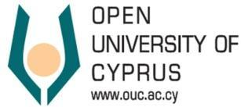





Universities in Cyprus
Public Universities
Private Universities

Slide 10
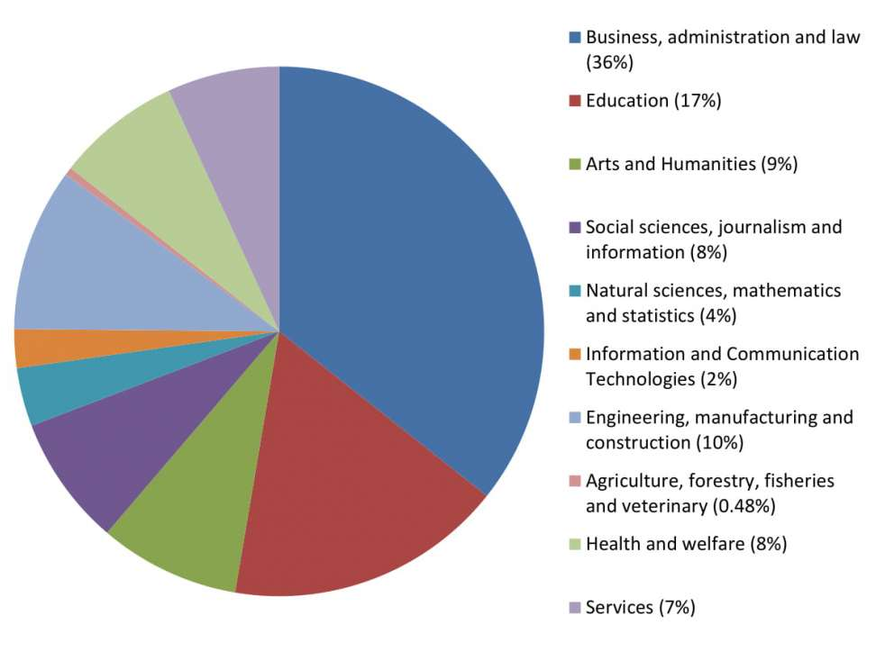
Which university subjects do students in Cyprus prefer?

Slide 11
Why to study in Cyprus
Quality education
A rising power in international education (students from 70+ different countries study in Cyprus)
Affordable Tuition Fees
Large International Community
Student Support Services
English Taught Programs of Study
1st safest small country in the world
Pleasant Mediterranean climate (2nd best climate worldwide)
The most blue flag beaches per coastline
Convenient location at the crossroad of Europe, Asia and Africa

Slide 12
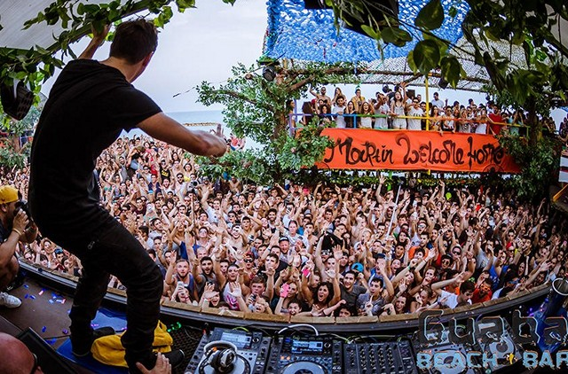
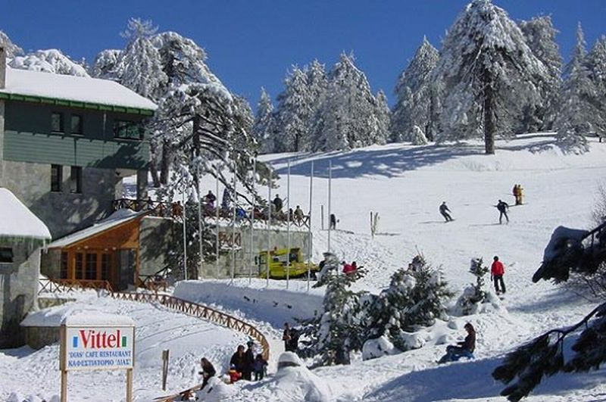
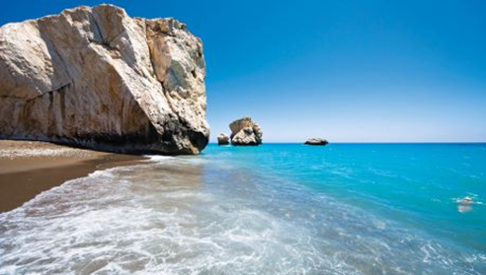
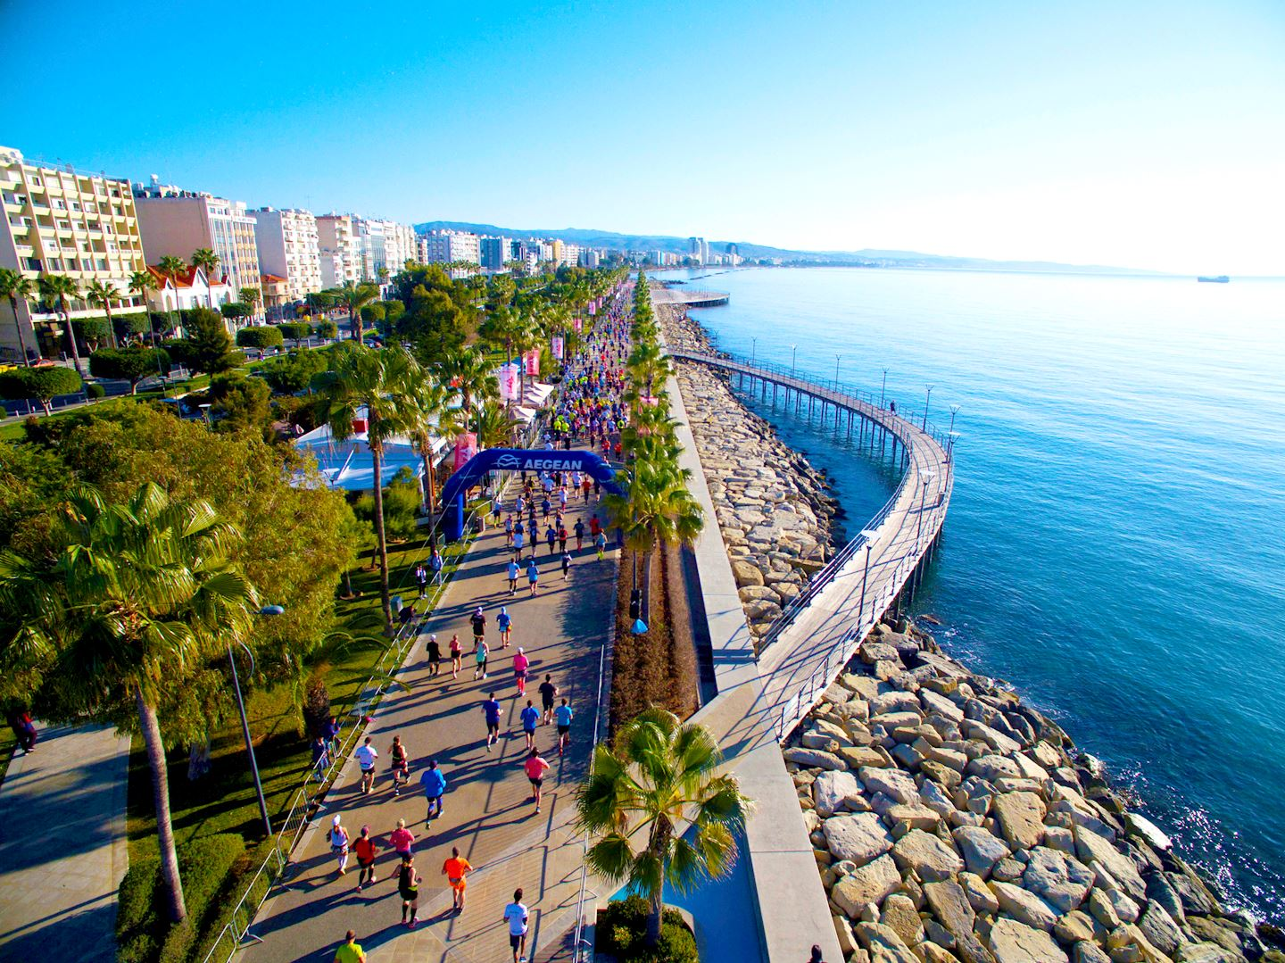
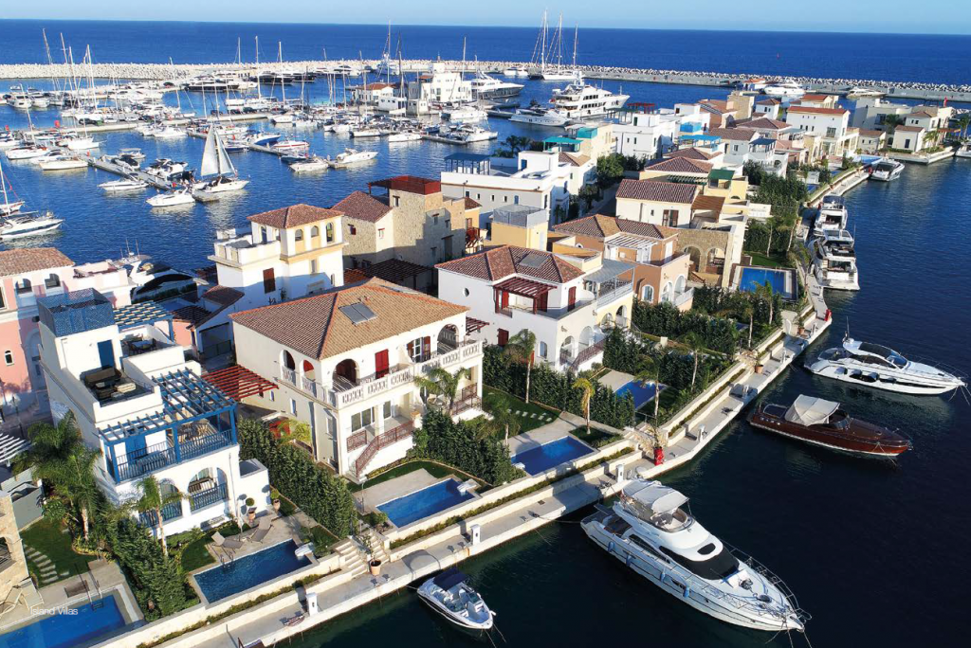
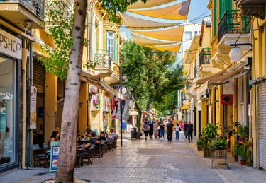
Life in Cyprus

Slide 13
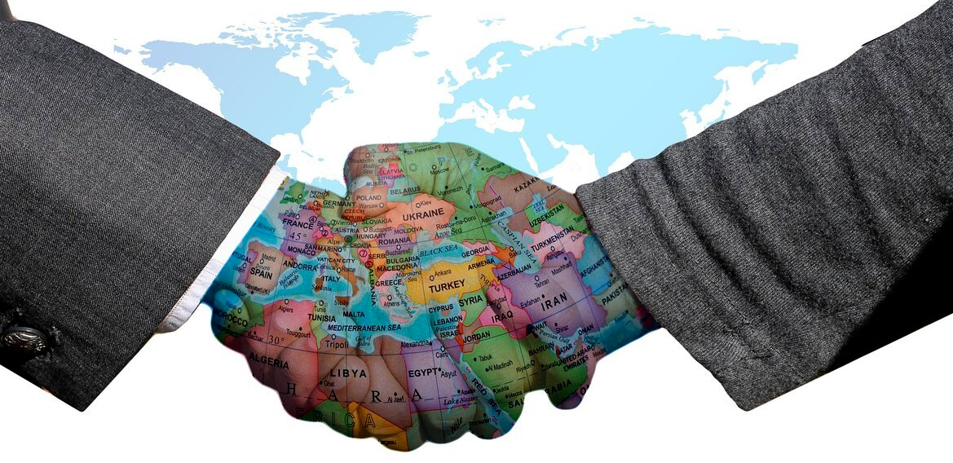
Diplomacy

Slide 14
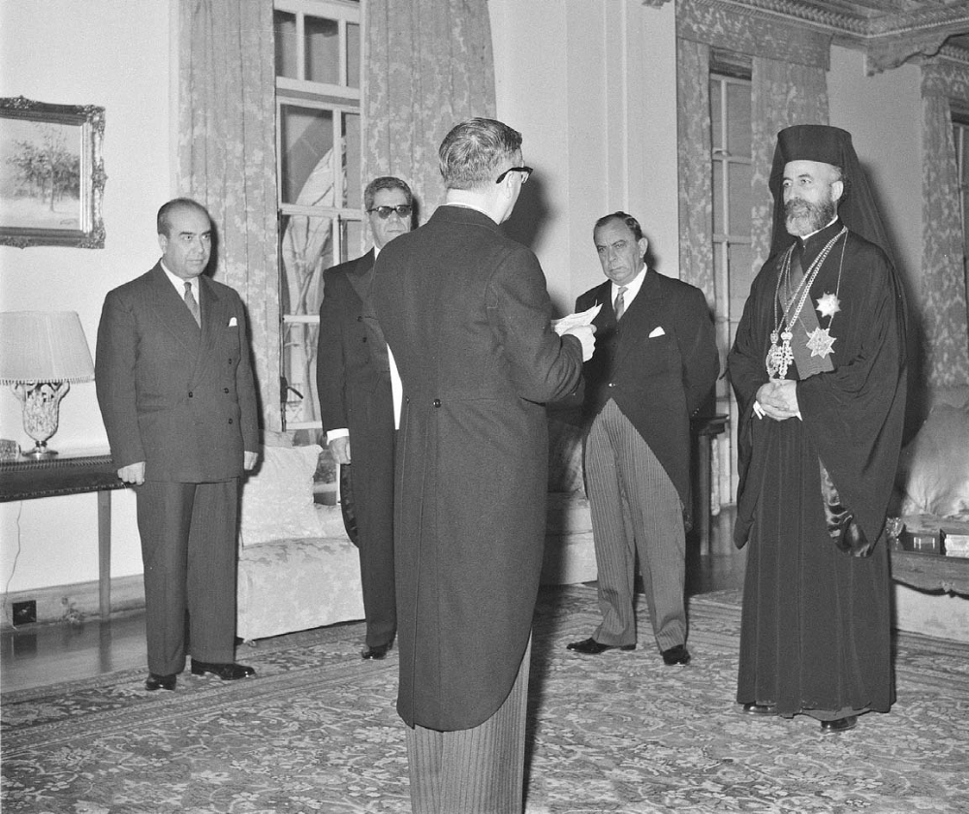
Diplomatic Relations Between Cyprus - Russia
The President of the Republic, Archbishop Makarios, received the credentials of the first Ambassador of the Soviet Union to Cyprus, Mr. Pavel Yermoshin, during an official ceremony at the Presidential Palace.
31.12.1960
Президент Республики Кипр Архиепископ Макариос принимает верительные грамоты нового Посла Советского Союза в Республике Кипр а
Павла Константиновича Ермошина во время официальной церемонии в Президентском дворце. 31.12.1960 г.

Slide 15
Areas of cooperation
for the years 2021 - 2022
Commerce and Economy
A large number of Russian entrepreneurs use Cyprus as their base for their business and investment activities
Cyprus imports from Russia mainly oil as well as iron, other metals, timber, etc.
Cypriot exports to Russia include mainly agricultural products, foodstuff and pharmaceuticals
Tourism - Since 2009, Russia is the second tourist power for Cyprus
Political and Legal
Amending Protocol to the Agreement on the Avoidance of Double Taxation
Culture
twining of cities
Education
joint research projects
youth exchanges

Slide 16
Russians in Cyprus
≈50 000 Russians live in Cyprus
4 Russian schools
1 Russian church has also been built in the Limassol city
Russian Commercial Bank (RCB) also has branches in Limassol, Nicosia and Paphos.
Russian stores with products from Russia
Many restaurants with Russian cuisine
2 Russian Newspapers
1 Russian Magazine
4 Russian radio stations
Russian Center for Science and Culture

Slide 17
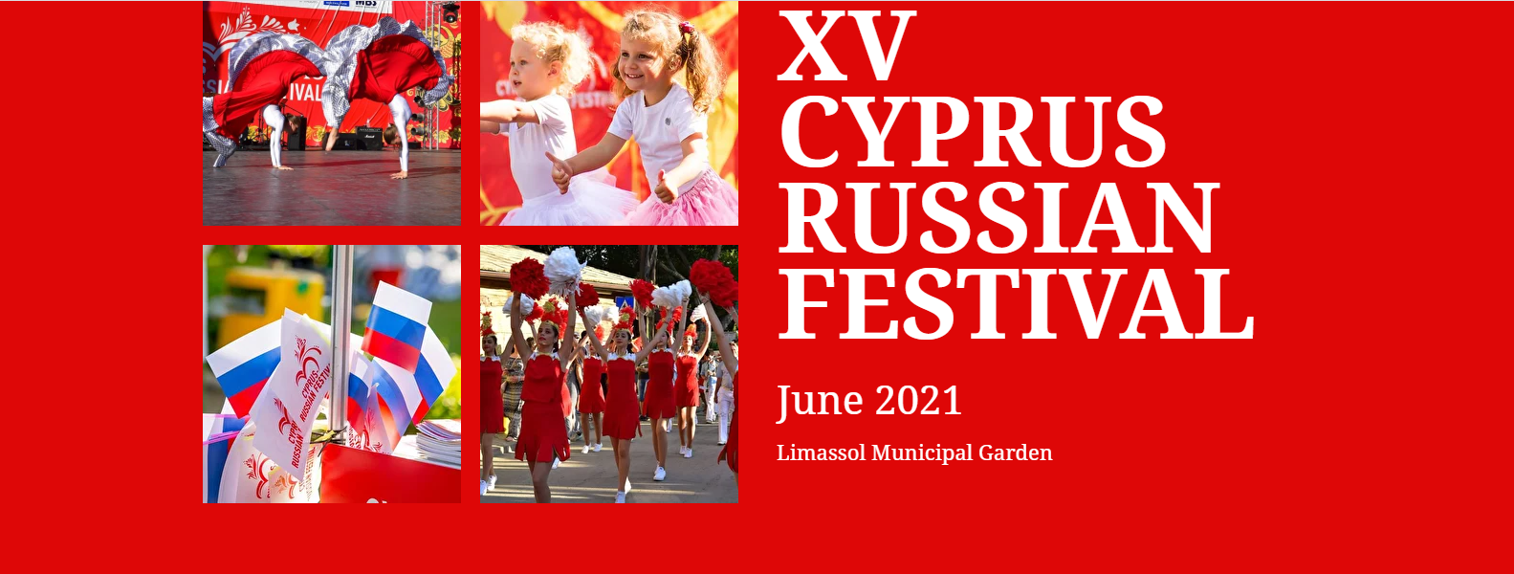
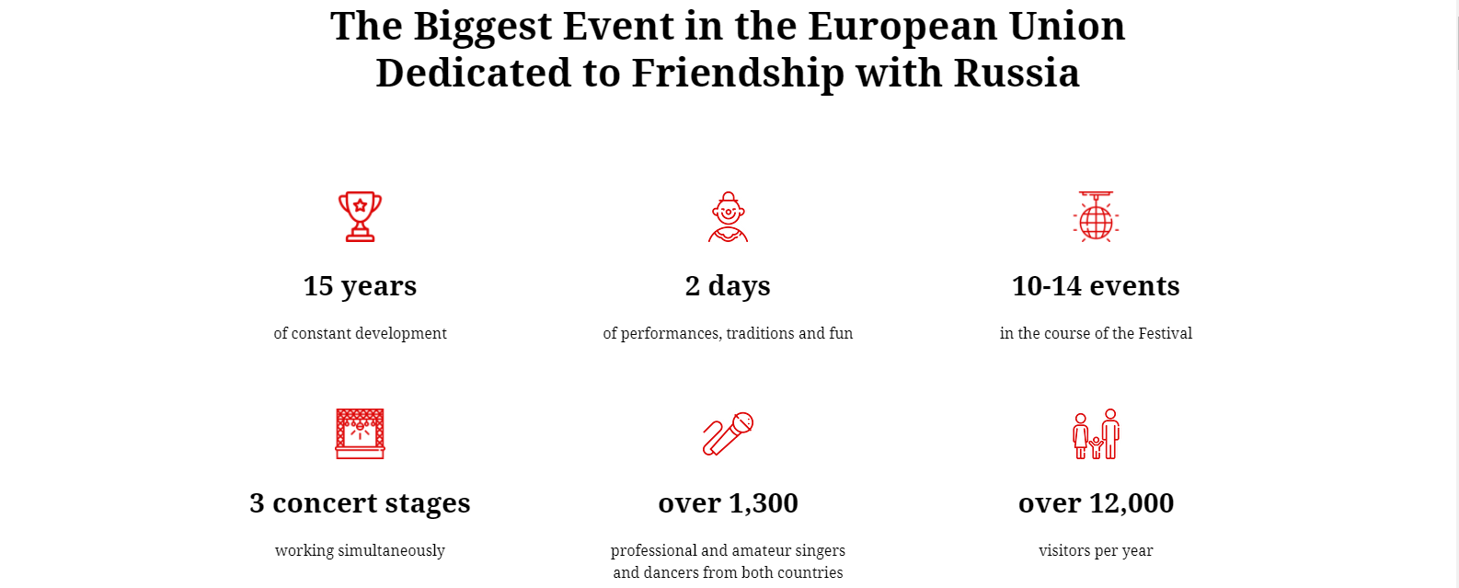

Slide 18
What a Diplomatic Mission does?
Represents its country to the host country
Protects the interests of its country and of its people
Negotiating with the Government of the host country
Monitors developments in the host country, and gives reports to its government
Promoting friendly relations between its country and the host country
Developing their economic, cultural and scientific relations
Different types of diplomatic missions:
An Embassy
main office of a Diplomatic Mission serving to another country
assist its national citizens who travel to or live in the host country
interview citizens of the host country who wish to travel to its country
Embassy personnel analyze the political and economic situation in the host country and report back to its Government on issues that affect its country
promotes ties between its country and the host country

Slide 19
High Commission
Diplomatic mission of a Commonwealth country located in another Commonwealth country.
Has the same roles and responsibilities as an Embassy
Consulate General
Further enhance and promote the existing relations between its country and the host country in the fields of business, tourism, culture, economy and education.
Offers consular support and services to its nationals living, or visiting the host country
Issues visas to foreign citizens who wish to visit its country
Consulate
Similar to a consulate general, but may not provide a full range of services.
Honorary Consulate
Help out the consuls, with things like enhancement of relations between the two countries
Honorary consul members are not diplomats by career and are not given any form of immunity
They cannot in any way or form issue visas or passports. They can only help build relations between the two countries

Slide 20
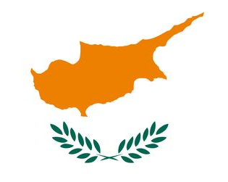
Контактная информация
Россия, 443000, г. Самара, ул. Чапаевская, 189
Телефон
+7 (846) 207 33 53 (общий)
+7 (846) 207 33 52 (Визовый отдел)
Е-mail
samaraconsulate@mfa.gov.cy
Социальные медиа
https://vk.com/public169935321
https://www.facebook.com/CyprusinSamara

